Slide 1


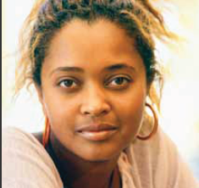

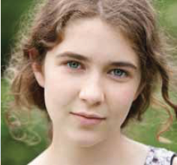


Supporting Your Child’s
Mental Health
February, 2017
Michelle Cassidy
Mental Health Lead
@mcassidy905

Slide 2

Notes:
Susan

Slide 3

Schools Have a Unique Opportunity
Schools are an optimal setting to:
    Reduce stigma
    Promote positive mental health
    Build student social-emotional learning skills
    Prevent mental health problems
    Identify people in need
    Build pathways to care
Notes:
Schools in Ontario have a unique opportunity to help overcome some of the problems that prevent children and youth from developing good mental health.
Schools are ideal settings in which to promote positive mental health by creating caring schools and classrooms, teach and strengthen social-emotional skills, provide support and monitoring for high risk students to prevent onset or worsening of mental health problems, reduce the stigma surrounding not just mental health problems but also counselling and therapy. School staff are also ideally positioned to help identify students who need mental health support, and to provide information and assistance for students and families seeking help.

Slide 4
Paradigm Shift
From a “topic” to comprehensive
From the role of community service providers to a shared responsibility

Slide 5
Mental Health is
NOT an
Event

Slide 6
What does comprehensive mean?
Staff
Students
Parents
Community

Slide 7


YRDSB Mental Health Strategy
Priorities

Slide 8
BIPSA for Student Achievement and Well-Being
Building Knowledge and Capacity
Developing Mentally Healthy Environments
Reducing Stigma
Creating Collaborative Care Pathways
Notes:
Michelle

Slide 9
Reducing Stigma

Slide 10
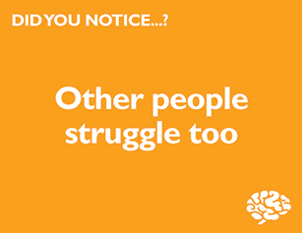
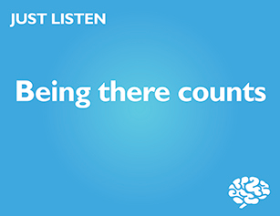
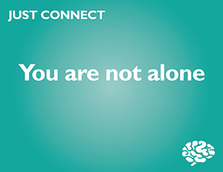
Stigma Reduction
Notes:
For the purposes of this presentation we will just give you a snapshot of the work of one working group: Stigma Reduction.
Created a system wide STIGMA REDUCTION campaign for Mental Health Week –NOTICE….LISTEN….CONNECT (Gr. 2-12, workplace)
This campaign was done by most during MH week but may be done at any time throughout the year
elements appropriate for all schools, and staff, and others just for students or staff
Follow up activities/resources are being sent to schools shortly.
This is part of the GOOD FOR ALL.

Slide 11
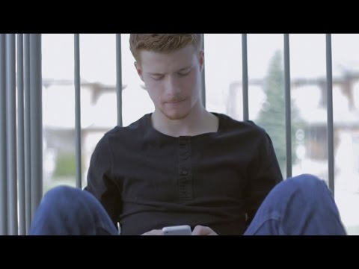
Mental Health
Notes:
Video supporting the Notice...Listen...Connect campaign.

Slide 12
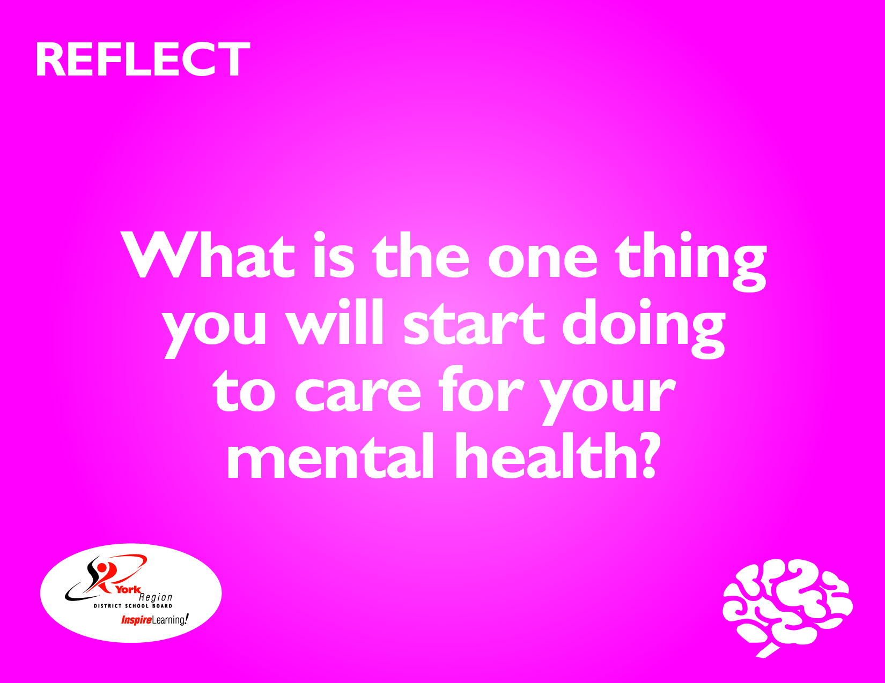
REFLECT

Slide 13
Breaking the Stigma V2.mov

Slide 14
Building Knowledge and Capacity
Notes:
Bev (from a leadership development strategy)

Slide 15
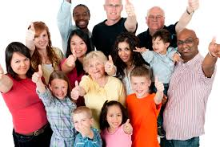
Audiences
All staff members
Students
Parents/Families
Community partners
Notes:
Bev- mention that building knowledge is for everyone…..we all need the same messages!

Slide 16
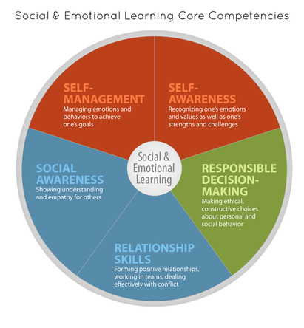
Social Emotional Learning
Notes:
Michelle

Slide 17
What does promoting mental health look like in school?
What is social emotional
learning (SEL)?
Not innate talent but learned abilities
Self Awareness
Self Management
Social Awareness
Relationship Management
What happens in mental health treatment:
Children and youth learn how to increase emotional and cognitive regulation
  Mindfulness
  Distress Tolerance
  Emotion Regulation
  Interpersonal Effectiveness
Notes:
Compare to cardiac care

Slide 18
Student Achievement improves..
When SEL taught in school:
Social, emotional skills increase
Positive attitudes and behavior increases
Student achievement increases 11% on standardized tests
Durlak et al., 2011

Slide 19

VIDEO
Mental Health Embedded--Student Voice
WELCOME – Welcoming and accepting school environments inspire a sense of belonging and help nurture a student’s identity within a larger community.
TEACH – At school, students can learn the skills, attitudes, knowledge and habits that build their personal resilience.
NOTICE – Caring adults at school can learn how to notice students who may be struggling with mental health.
PARTNER – By guiding them through clear pathways to care, school personnel can help families with mental health assessments and treatment services.
Notes:
Michelle

Slide 20
Our Task as Parents and Educators
To prepare our children/students to be:
Ready for the post secondary and employment world
Positive contributors to society
Healthy and Thriving

Slide 21

What do we mean when we talk about mental health?

Slide 22
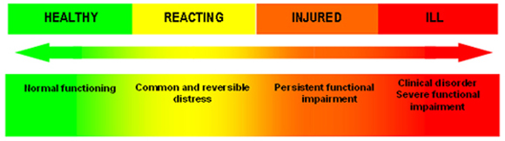
Holistic Approach

Slide 23
Our Students
“I feel like people won’t value me if I don’t do well at school”
32% Elem 39% Sec
“I usually hide my feelings of anxiety and sadness”
58% Elem 64% Sec
“I feel I am expected to be perfect ”
46% Elem 54% Sec

Slide 24
Impairing Well-Being
Students feel their worth/value connected to school achievement
Many indicating they don’t have hope for future
Limited physical activity
Many students indicate they don’t think they matter to others
What is the impact on feeling safe?

Slide 25
How can we together promote mental health for all?

Slide 26


Slide 27
Why Does this Happen?
The Power of the Brain
Notes:
Cassidy

Slide 28
Designed to keep our body in balance
Our body craves homeostasis
The brain supports adaptive functioning
It is hardwired to protect us
Notes:
Cassidy

Slide 29
Why is this important?
Flight,
Fight,
or
Freeze
Notes:
Cassidy

Slide 30
A Helpful Brain Model
Dr. Daniel Siegel
Notes:
CASSIDY

Slide 31
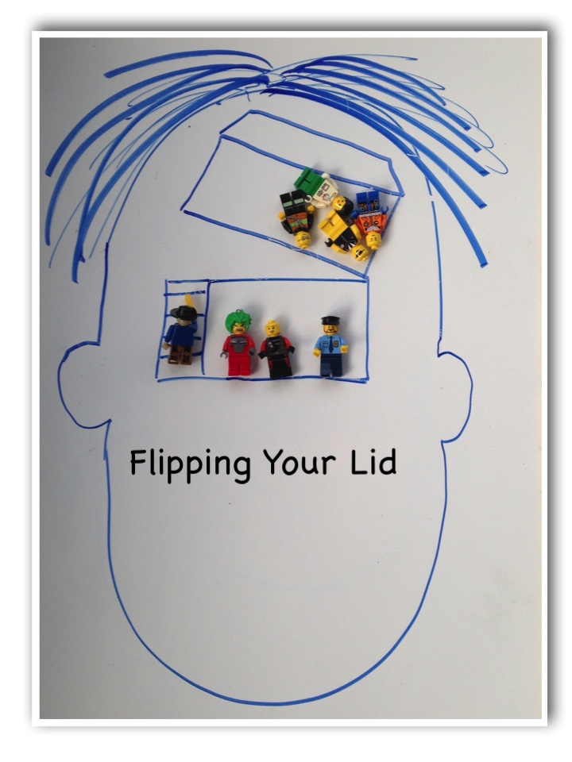

Slide 32
Changing the Brain
We need our brain to have the alarm system, we wouldn’t want to turn if off BUT higher level cortical functions help us moderate it
Plasticity allows us to strengthen how the brain regulates
Pruning gets rid of circuits we don’t use
Notes:
CASSIDY
Negativity bias
Attachment
Startle response

Slide 33
Creating Safety
Sending the brain a message of safety

Slide 34
The Power of Relationships
YOU MAKE A DIFFERENCE!
Cultivating relationships which promote mental health

Slide 35

The Myth of SELF Regulation
https://youtu.be/Wz1pnFBLZM4
Notes:
Mirror neurons

Slide 36

We all have a primal need to

Slide 37
Family Mealtimes
Schedule them if you have to
No technology, including answering the phone
Structure the conversation, must be positive
Devote one meal month to each family member (choice of meal, pick the positive conversation starter, and 1 affirmation)**identity development

Slide 38
Family Dinner

Slide 39
….teach me HOW to calm down don’t just TELL me to…

Slide 40
Understanding the Triad
S.O.S
STOP….OBSERVE….SHIFT
MIND
Thoughts/Feelings
Behaviors
BRAIN/BODY
Physiology

Slide 41
Shifting the Triad: Modifying thoughts
Thoughts/Feelings
Notes:
Shilagh

Slide 42
Cognitive Reframing
Adapted from: D. Bilsker, M. Gilbert, D. Worling & E. J. Garland
Situation | Thoughts Thinking Error | Realistic Thoughts
 | All or Nothing Thinking Overgeneralization Disqualifying the positive Jumping to conclusions | What proof do I have? Would most people agree with this thought? If not, what would be a more realistic thought? What would I say to a friend in a similar situation?

Slide 43

Self Compassion
Not about judging ourselves positively, but a way of relating to ourselves kindly, embracing ourselves lovingly flaws and all

Slide 44
Gratitude and Joy
Gratitude Lists
Gratitude Journal
Joy List/Joy Calendar
Practice of Gratitude Affirmations

Slide 45
Changing our Response:
Modifying Physiology
Sensation/Physiology
Notes:
CASSIDY

Slide 46

Strategies: Take up Smoking
Just kidding!
Why this works:
Taking a break physically from place/environment which generates stress
Deep breathing
Let’s practice…
4, 7, 8 Breathing

Slide 47
Mindfulness
A seated meditation may be easiest OR a body scan
Seated Body Scan
MARC.ucla (Mindfulness Awareness Resource Centre) meditation recordings iTunes U
Guided Mindfulness
(free audio guided meditations)

Slide 48
Shifting the Triad: Modifying Behaviour
Behaviour
Notes:
Shilagh

Slide 49
Importance of Sleep
2 types of sleep:
Restorative sleep
Non-restorative sleep
Large increase in children, youth and adults getting primarily non restorative sleep…
3 primary factors:
Lack of physical activity
Blue Light
Stress/Anxiety

Slide 50
Get the body moving
(full range of motion activities, tension and release)
Get outside~
Nature

Slide 51
Your role in supporting your child
Practice stress reduction with your child
Celebrate all aspects of your child—character, personality, school, work etc.
Deliver messages of self compassion
Get help if you feel their/your stress level is impacting you in ways you cannot manage
Notes:
Stress becomes a problem when you feel overwhelmed by the things that happen to you. You may feel “stressed out” when it seems there is too much to deal with all at once, and you are not sure how to handle it all.
When you feel stressed, you usually have some physical symptoms. You can feel tired, get headaches, stomach upsets or backaches, clench your jaw or grind your teeth, develop skin rashes, have recurring colds or flu, have muscle spasms or nervous twitches, or have problems sleeping.
Mental signs of stress include feeling pressured, having difficulty concentrating, being forgetful and having trouble making decisions.
Emotional signs include feeling angry, frustrated, tense, anxious, or more aggressive than usual.

Slide 52
Who we are and how we engage in the world are much stronger predictors of how our children will do than what we know about parenting.
The question isn’t are you parenting in the right way?
The question is:
Are you the adult you want your child to grow up to be?
Brene Brown

Slide 53
Are you ready to change the lens?
The Power of Positive Psychology

Slide 54
The 21 day Challenge
Daily:
Write down 3 new things you were grateful for that day
Journal one positive experience
Exercise
Meditation
One random act of kindness

Slide 55
WEB Resources
Websites:
Parents for Children's Mental Health
Anxiety BC
Anxiety BC Parent Toolkit
Mind Your Mind
Physical Activity
Sleep Benefits
Better Sleep for Children
Better Sleep for Teens
Screen Time Overview
Healthy Screen Time Limits
Healthy Eating and Mental Health
Understanding Anxiety
Parenting for Life Tip Sheet
Parenting for Life Booklets.

Slide 56
BOOKS
Building Emotional Intelligence (Linda Lantieri)
Flourish (Dr. Seligman)
The Mindful Child (Susan Kaiser Greenland)
Brainstorm: The Power and Purpose of the Teenage Brain (Daniel Siegal)
The Highly Sensitive Child: Helping Our Children Thrive When the World Overwhelms Them (Elaine Aron)
Keys to Parenting Your Anxious Child, (Dr. Katharina Manassis)
Worried No More, Second Edition: Help and Hope for Anxious Children (Aureen Wagner)
Freeing Your Child From Anxiety, (Tamar Chansky)
Helping Your Anxious Child (Ronald M. Rapee)

Slide 57
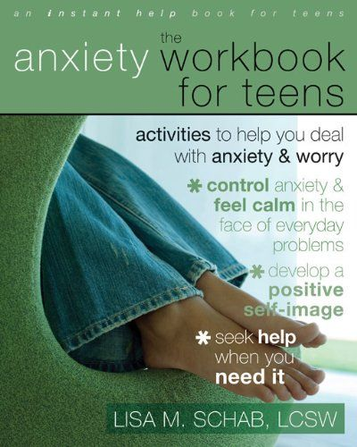

Slide 58
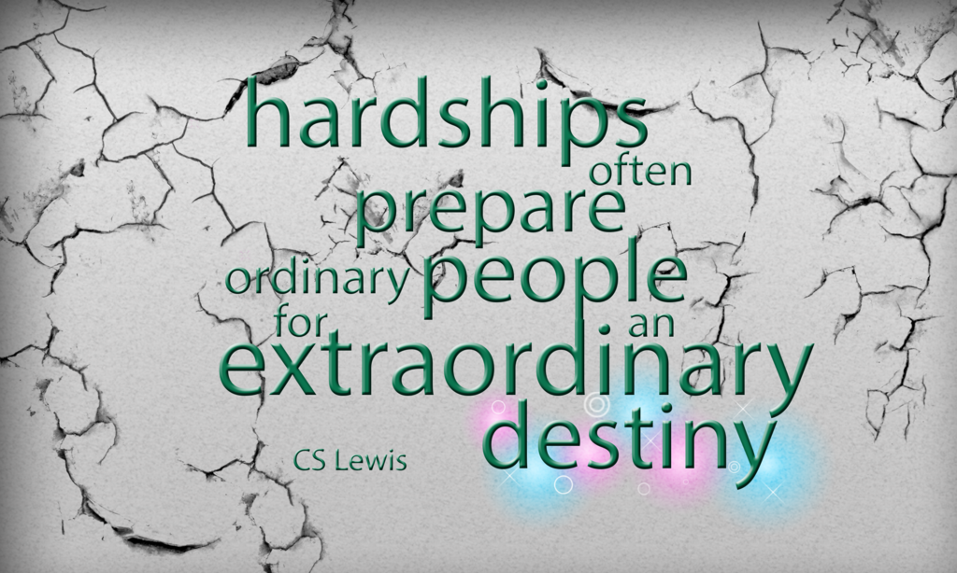

Slide 59

Questions?
Notes:
Susan

